Slide 1
File Processing
Simplified view of File System & File I/O

Slide 2
References
File Descriptor: https://www.computerhope.com/jargon/f/file-descriptor.htm
File System: https://slideplayer.com/slide/5229567/
File Structure: https://www.mysterybox.us/blog/2017/7/27/protecting-your-digital-assets-part-3-recovering-from-failure
https://www.programiz.com/c-programming/c-file-input-output#closing

Slide 3
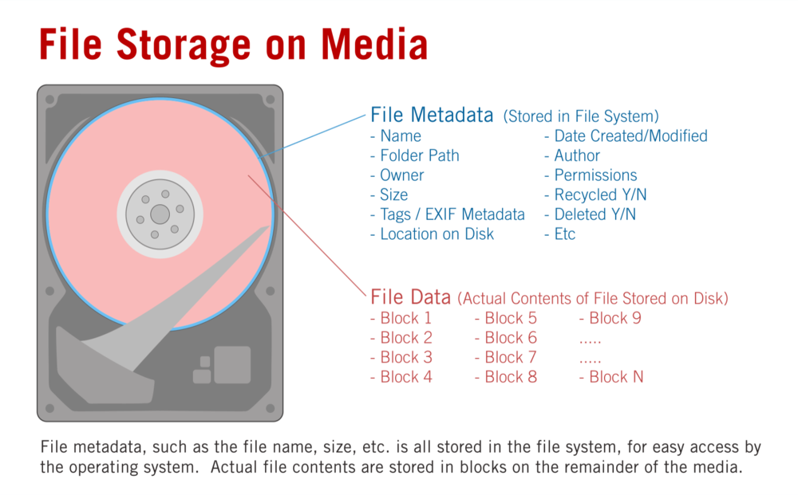
Files Storage
Files are stored in external storage
HD
SSD (these days)
Both
We are essentially talking about files in HD in the presentation
File includes Meta Data and & File Data
Both data are stored in external storage
Inode is a pointer Meta-Data

Slide 4
File Cluster - Chaining
Typically, a large file is stored in multiple clusters
The clusters are chained using pointers
The Meta Data for a file includes a pointer to the first cluster of the file
Example: File 2 contains 4 clusters
Indexing can also be used as an alternative to chaining
Why a file is in multiple discontinuous clusters?

Slide 5
File system
Appl Prog
User
process
Stdio Library
File System
File System
Operating
System
Storage
Driver
Disk
Why File System Abstraction?
Why do we need File System Abstraction in OS?

Slide 6
Communicating with OS
System call
Request to the operating system to perform a task that the process does not have permission to perform
Signal
Asynchronous notification sent to a process to notify the process of an event that has occurred
Standard Library Calls
Generic I/O support
A smart wrapper around I/O-related system calls. This means, system calls are normally embedded in some library calls.
User Process
signals
systems calls
Operating System

Slide 7
System Calls
Method for user process to invoke OS services
Called just like a function
Essentially a “protected” function call
That transfers control to the OS and back
User
Process
Application
OS
File System

Slide 8
Implementing a System Call
System calls are implemented using traps (SWI)
OS gains/given control through trap
Switches to supervisor mode
Performs the service
Switches back to user mode
Gives control back to user
Which call?
1: close
2: Read Int
3: Read Char
4: write Int
…
SWI 0x69
Trap to the OS
System-call specific arguments are passed with SWI
Notes:
“int $0x80” transfers to a particular point in the OS code, saves all of the registers, checks that a valid system call was invoked (i.e., range checking on eax), and transfers control to the code for the specific system call (using an offset table indexed by eax)

Slide 9
Library and API (Context is C Language)
API stands for Application Programming Interface (as opposed to UI)
API is closely related to library
API is the specification of library – Library is an implementation of an API
API specification includes the following for every function in the library
Declaration: Function Name, Return Value, and its Arguments, & documentation – pretty much the content of header file
Library includes
Definition: Implementation of those functions (There can be multiple libraries for the same API!) – (content of corresponding .c file)
A C Library can either dynamic (.dll) or static (.lib)
Library: stdio (stdio.h) with printf and scanf functions.

Slide 10
Using Lib in your C program
Include the header file to DECLARE the library functions
Link the library either statically (lib) or dynamically (.dll) to your code for its DEFINITION
Static linking is done at Compile time – by specifying the libraries that you need in your program
Dynamic linking done at run time. DLL in RAM are shared by more than 1 program. Thus, they are written to be re-entrant.

Slide 11
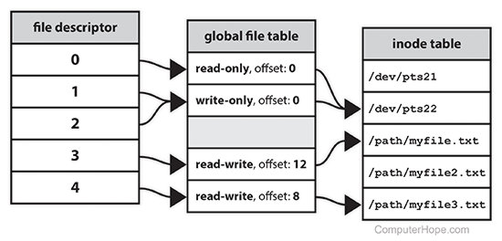
File Handle
When a process makes a successful request to open a file, the kernel returns a file descriptor which points to an entry in the OS’s global file table.
The file table entry contains pointer to inode of the file, byte offset, and the access restrictions etc.
The inode is the Meta Data for a file

Slide 12
File with Tcl
Why Tcl? Simpler and easy to work with in classrooms. Our objective here is to learn File I/O not to deal with logistical and compilation errors. Here also we encounter syntactical issues, but we can build and test code faster

Slide 13
Special Files: Stdin, stdout, and stderr
Name | File descriptor | Description | Abbreviation
Standard input | 0 | The default data stream for input, for example in a command pipeline. In the terminal, this defaults to keyboard input from the user. | stdin
Standard output | 1 | The default data stream for output, for example when a command prints text. In the terminal, this defaults to the user's screen. | stdout
Standard error | 2 | The default data stream for output that relates to an error occurring. In the terminal, this defaults to the user's screen. | stderr

Slide 16
File I/O – Example
proc fileRead {fname} {
set chid [open $fname r]
while {![eof $chid]} {
set line [gets $chid]
puts $line
}
close $chid
}

Slide 18
Hexdump
Hexa decimal dump of file can allow us to seen the content of file with control characters like <LF>(\n -0xd) and <CR> (\r - 0Xa) etc
Hex Editor Neo – Download and install on your laptop
Use this to view the content of a file
Understand how cursor movement over file treats <LF> and <CR>

Slide 20
Exercise
Open a file (input.txt) in a read mode
Open another file (output.txt) in Write mode
Copy the contents of input file to output file
Close both files – validate your program
Check out the cursor position while reading the content of a file
Move the cursor to the print and read it again

Slide 21
ARMSIM
File Processing

Slide 22
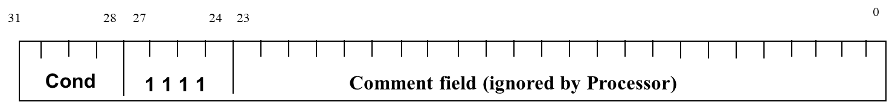
Software Interrupt (SWI)
SWI is an ARM assembly instruction
An assembly program uses the SWI to create an exception and thus passing the control to System
SWI is a single operand instruction; operand size is 24 bits in size
The operand value informs the system the reason for the exception
ARM SWI is used to invoke privileged functions like I/O & Memory operations that are directly available to user program
ARMSim uses this mechanism in supporting two Plugin UIs

Slide 23
ARM SIM – File I/O Plugin Exceptions (1)

Slide 24
ARM SIM – File I/O Plugin Exceptions (2)

Slide 25
ARM SIM – Opening a File for Input/Output
FileName: .asciz “test.s"
.align
FileHandle: .word 0
ldr r0,=FileName
mov r1,#0
swi 0X66
ldr r1,=FileHandle
str r0, [r1]
Swi 0x11
0x2000
0x2004
0x2008
Opening a file for output is done by #0 to #1 in line 5
0

Slide 26
ARM SIM – Reading a string from a file
ldr r0,=FileHandle
ldr r0,[r0]
ldr r1,=CharArray
mov r2,#80
swi 0x6a
bcs ReadError
...
FileHandle: .word 0
CharArray: .skip 80
0x2000
0x2004
0x2008
Error handling is critical to developing good program
12

Slide 27
File Close
;load the file handle
ldr r0,=FileHandle
ldr r0,[r0]
swi 0X68 ;close the file

Slide 28
File Output
File output is similar to file read
Open the file
Write to it using SWI 0x69
Close the file

Slide 29
ARM SIM – Writing a string to a file
ldr r0,=OutFileHandle
ldr r0,[r0]
ldr r1,=TextString
swi 0x69
bcs WriteError
...
TextString: .asciz “Hello!\n "
0x2000
0x2004
0x2008
0
The file handle for STDOUT is #1. No need for Open for STDOUT, STDIN and STDERR

Slide 30
ARMSIM – Working with Embest Plugin
Embest plugin includes a number of simple I/O devices
8-segment display, LED lights, Input toggle buttons, and a numeric key board
SWI implementation supports exception handling to work with these devices

Slide 31
ARMSIM – Embest LED – Exception Code
mov r0,#0x02
swi 0x201 ; left LED on
mov r0,#0x01
swi 0x201 ; right LED on
mov r0,#0x03
swi 0x201 ; both LEDs on
mov r0,#0x00
swi 0x201 ; both LEDs on
Read and understand the SWI Exception tables for both I/O and Embest Plugin
No need to remember the exception or code

Slide 32
Exercise
Read a file line by line; if you read 0 characters assume that you reached the end of the file.
As you, write the line to an output file
At the end close both files

Slide 33
Exercise (Optional)
Input file contains two character strings of 128 characters
These character strings include only 0s and 1s
Perform binary addition of these two strings
Your output should appear on STDOUT as follows: C = <0|1> SUM= <sum of those two strings without the carry>

Slide 34
Disk Structure
We will do this topic later

